Slide 1
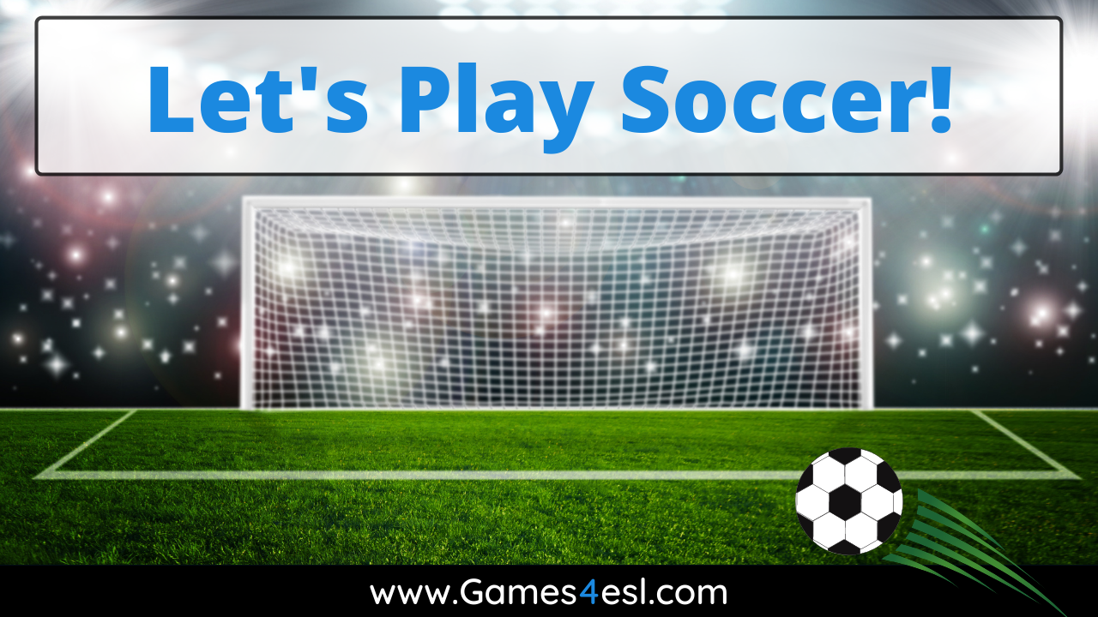

Slide 2
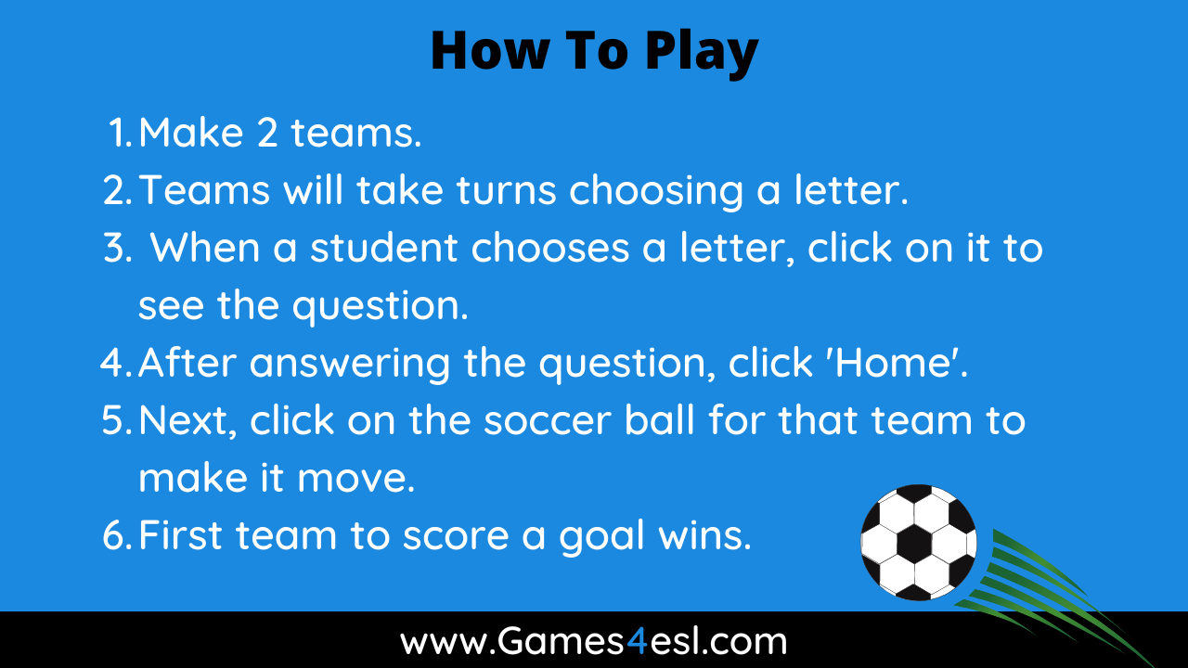

Slide 3
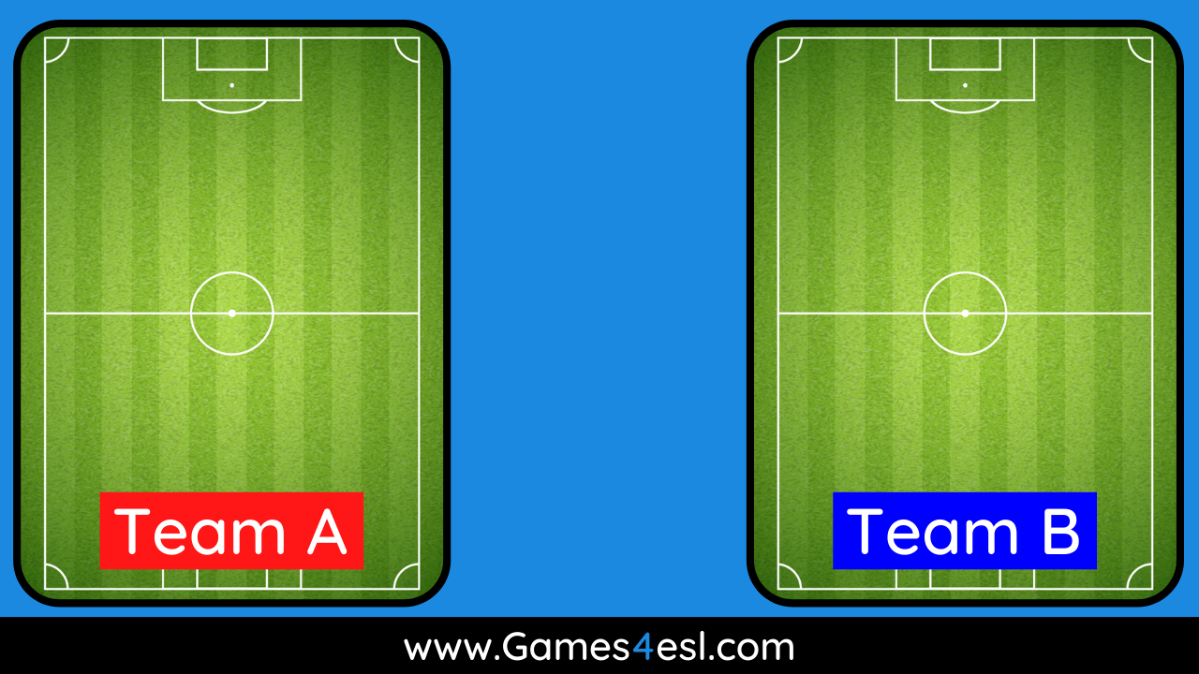
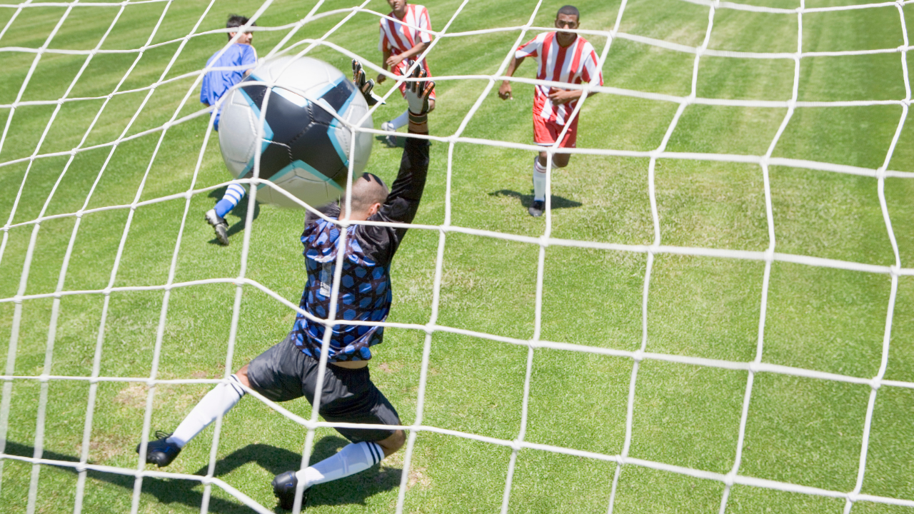


A
B
C
D
E
GOAL!!!!
GOAL!!!!
F
G
H
I
J
K
L

Slide 4
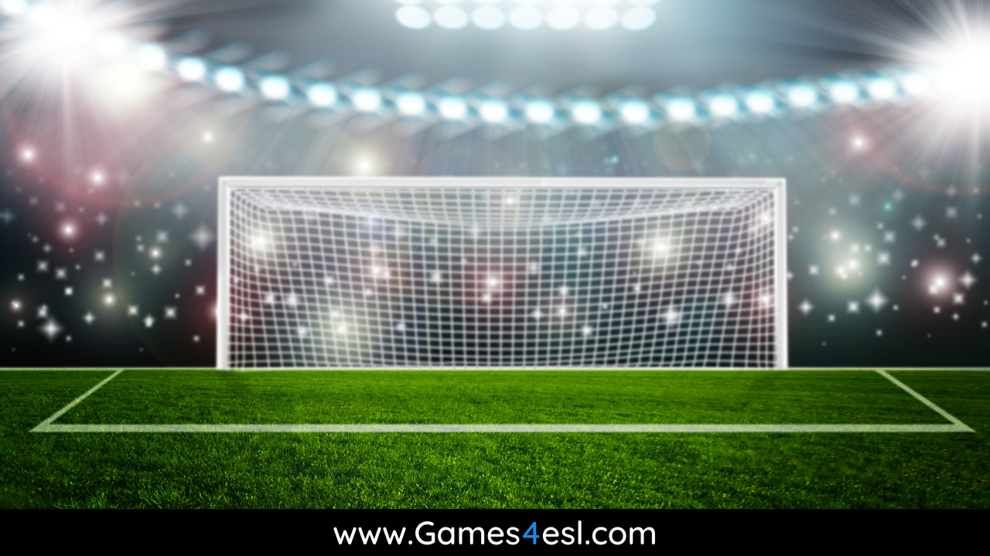
Question Here
Answer Here

Slide 5
Question Here
Answer Here

Slide 6
Question Here
Answer Here

Slide 7
Question Here
Answer Here

Slide 8
Question Here
Answer Here

Slide 9
Question Here
Answer Here

Slide 10
Question Here
Answer Here

Slide 11
Question Here
Answer Here

Slide 12
Question Here
Answer Here

Slide 13
Question Here
Answer Here

Slide 14
Question Here
Answer Here

Slide 15
Question Here
Answer Here

